Slide 1
AI Mental Health Chatbot
Exploring the Role of AI in Mental Well-being
TEAM MEMBERS
NAVIN KUMAR S
NIGILAN PREMKUMAR P
NANDHA KUMAR S
MOHAMMAD ARSHATH K H

Slide 2
Introduction
This presentation explores AI chatbots in the mental health space, highlighting their functionalities, benefits, and future trends.

Slide 3
01
Overview

Slide 4
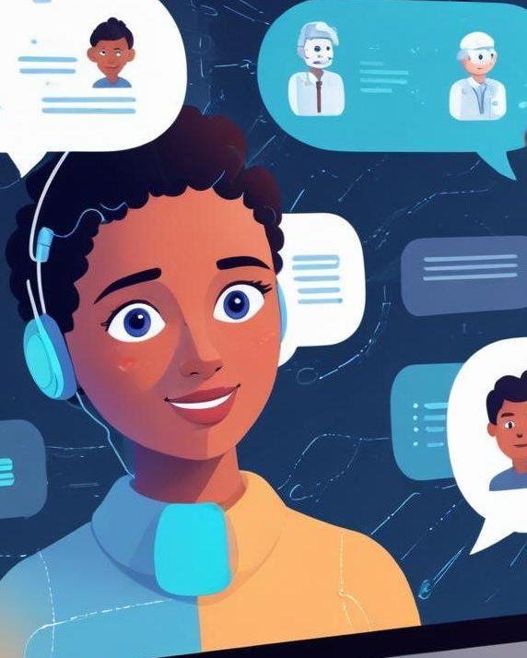
Definition of AI Chatbots
AI chatbots are software applications that utilize artificial intelligence to simulate human-like conversation. They analyze user input and provide appropriate responses, creating an interactive experience that aids in communication, particularly in mental health support.

Slide 5
Importance in Mental Health
AI chatbots offer immediate support for mental health issues, providing users with information, resources, and coping strategies. Their ability to operate 24/7 allows them to reach individuals who may not seek traditional therapy, thus expanding access to mental health resources.

Slide 6
Trends in Technology
The integration of AI in mental health is on the rise, with advancements in machine learning and natural language processing leading to more sophisticated chatbots. Moreover, collaborations with healthcare systems are increasing, enhancing the chatbots' functionality and reliability.

Slide 7
02
Functionality

Slide 8
Natural Language Processing
Natural Language Processing (NLP) allows chatbots to understand and interpret human language, making interactions more natural and intuitive. Through NLP, chatbots can analyze user emotions and respond appropriately, facilitating meaningful conversations.

Slide 9
User Interaction
User interaction is central to the effectiveness of AI chatbots. Through engaging interfaces and conversational design, these chatbots can provide tailored responses, creating a supportive atmosphere that encourages users to express their feelings and thoughts.

Slide 10
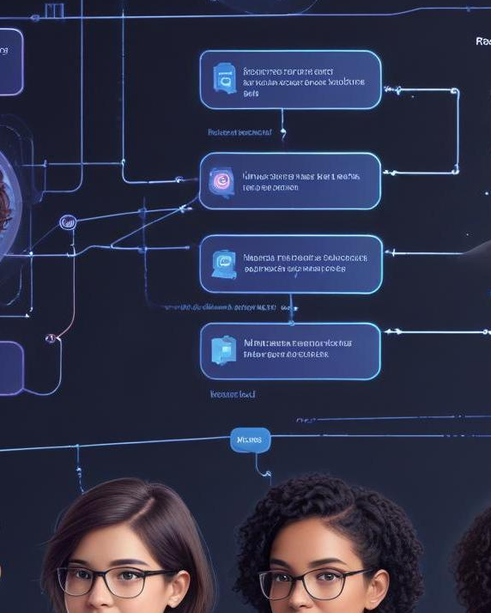
Response Generation
Chatbots utilize algorithms to generate responses based on user input. Advanced systems can create personalized responses that reflect user sentiment and provide relevant advice, thereby enhancing the user experience and support.

Slide 11
03
Benefits

Slide 12
Accessibility for Users
AI mental health chatbots enable users to access support regardless of location or time. They provide valuable resources to those who may not have traditional therapy available or are unable to visit a professional, enhancing overall mental health support.

Slide 13
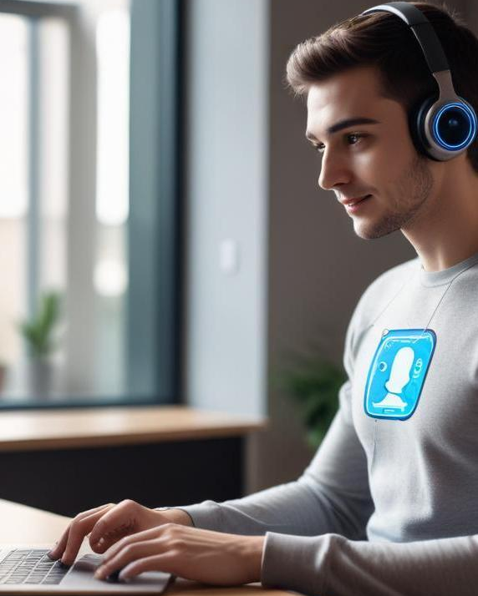
Anonymity and Comfort
The anonymous nature of chatbots allows users to discuss personal concerns without fear of judgment. This can lead to increased openness and honesty in sharing feelings, which is crucial for effective mental health support.

Slide 14
24/7 Availability
AI chatbots are available around the clock, providing immediate support whenever users may need it. This constant accessibility means that individuals can reach out during times of crisis or emotional distress, ensuring timely assistance.

Slide 15
04
Limitations

Slide 16
Lack of Human Empathy
While AI chatbots can provide information and support, they lack genuine human empathy and understanding. This emotional disconnect can limit their effectiveness in handling sensitive mental health issues where nuanced human interaction is often required.

Slide 17
Data Privacy Concerns
Data privacy is a significant concern with AI chatbots, as sensitive information shared by users must be handled securely. Users may feel hesitant to disclose personal details due to fears of data breaches or misuse of their information.

Slide 18
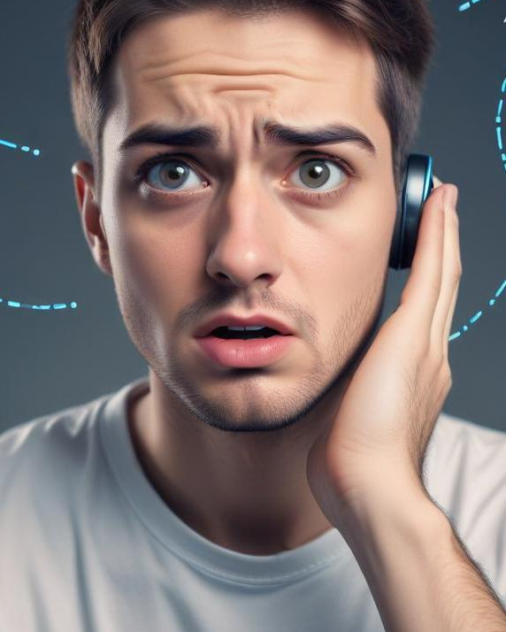
Potential Misunderstandings
AI chatbots can sometimes misinterpret user input, leading to inadequate or irrelevant responses. This limitation could create frustration and may deter users from seeking help when needed.

Slide 19
05
Future of AI Chatbots

Slide 20
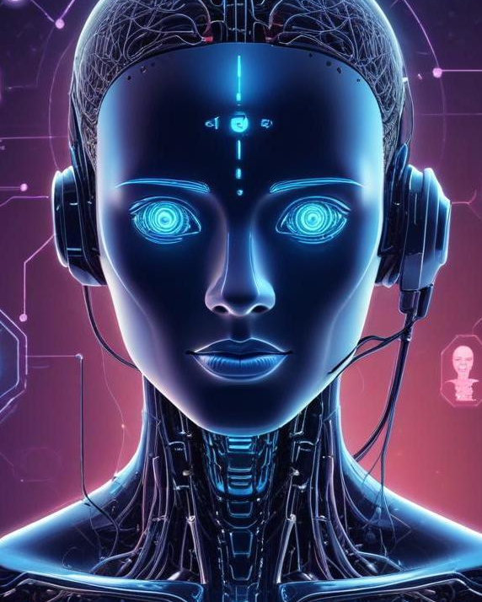
Advancements in AI Technology
The future of AI in mental health looks promising with ongoing advancements in machine learning and NLP. Improved algorithms will enhance chatbots’ ability to understand context and provide more personalized support, making them increasingly effective.

Slide 21
Integration with Healthcare Systems
Future AI chatbots will likely integrate more seamlessly with traditional healthcare systems, allowing healthcare providers to offer blended services. This integration can enhance the overall effectiveness of mental health care and provide a more comprehensive support system for users.

Slide 22
Ethical Considerations
As AI chatbots become more prevalent in mental health, ethical considerations will arise regarding their use and impact. It is essential to ensure that these tools are used responsibly, prioritizing user safety and ensuring accurate support.

Slide 23
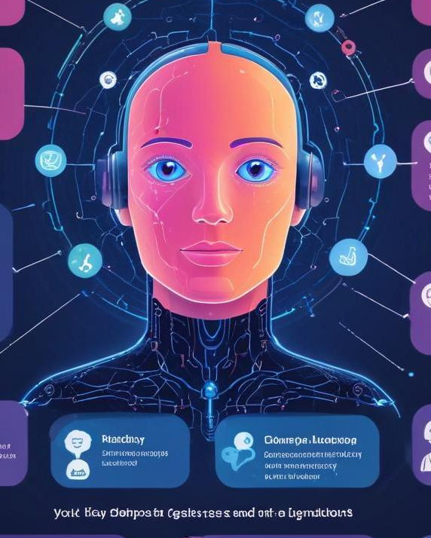
Conclusions
AI mental health chatbots present a promising alternative for support, with their accessibility and innovative technology. However, it is crucial to address their limitations and prioritize ethical practices as the field evolves.

Slide 24

Notes:
THANK YOU
DO YOU HAVE ANY QUESTIONS?

